Slide 1

APEX INSTITUTE OF TECHNOLOGY
DEPARTMENT: CSE
Bachelor of Engineering (Computer Science & Engineering)
Machine Learning
DISCOVER . LEARN . EMPOWER

Slide 2
Machine Learning
Course Objectives
Sr. No | Title
1 | To introduce students to the basic concepts and techniques of Machine Learning.
2 | To develop skills of using recent machine learning software for solving practical problems.
3 | : To gain experience of doing independent study and research.

Slide 3


Machine Learning
Course Outcomes
After this course student will be able to:
Have a good understanding of the fundamental issues and challenges of machine learning: data, model selection, model complexity, etc.
Appreciate the underlying mathematical relationships within and across Machine Learning algorithms and the paradigms of supervised and un-supervised learning.
Design and implement various machine learning algorithms in a range of real-world applications.
II
*
I

Slide 4
Regularized Regression
Regularization is a very important concept that is used to avoid overfitting of the data especially when the trained and tested data are much varying.
Regularization is implemented by adding a “penalty” term to the best fit derived from the trained data, in order to achieve a lesser variance with the tested data and also restricts the influence of predictor variables over the output variable by compressing their coefficients.
Notes:
https://towardsdatascience.com/regression-with-regularization-techniques-7bbc1a26d9ba

Slide 5
Ridge Regression
Ridge regression is a technique that is implemented by adding bias to a multilinear regression model to expect a much accurate regression with tested data at a cost of losing accuracy for the training data.
The general equation of a best-fit line for multilinear regression is
y = β₀ + β₁x₁ + β₂x₂ + ··· β_{k}x_{k}
where y is the output variable and x1,x2…xk are predictor variables.
The penalty term for ridge regression is λ(slope) ², where lambda denotes the degree of deflection from the original curve by restricting the coefficients of predictor variables but never makes them zero. Therefore the equation for ridge regression is
y = β₀ + β₁x₁ + β₂x₂ + ··· β_{k}x_{k} + λ(slope) ²

Slide 6
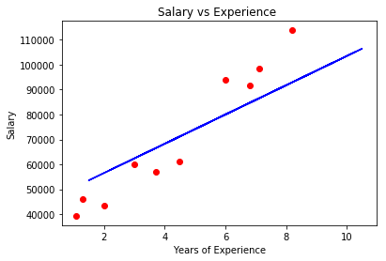
Ridge Regression
Courtesy: https://towardsdatascience.com/regression-with-regularization-techniques-7bbc1a26d9ba

Slide 7
Lasso Regression
Lasso regression is much similar to ridge regression but only differs in the penalty term. The penalty for lasso regression is λ|slope|. Lesso regression can even eliminate the variables by making their coefficients to zero thus removing the variables that have high covariance with other predictor variables.
The equation for lasso regression is
y = β0 + β1x1 + β2x2 + ··· βkxk + λ|slope|

Slide 8
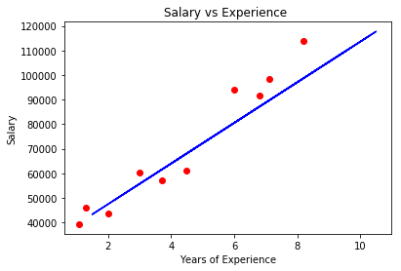
Lasso Regression
Courtesy: https://towardsdatascience.com/regression-with-regularization-techniques-7bbc1a26d9ba

Slide 9
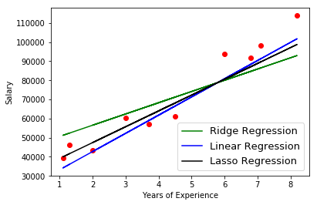
Comparison of lasso and ridge with the linear regression model
Courtesy: https://towardsdatascience.com/regression-with-regularization-techniques-7bbc1a26d9ba
Notes:
All the three plots must pass through a single point that is ( x̄, ȳ), where x̄ is the mean of predictor variables and ȳ is the mean of the output variable.

Slide 10
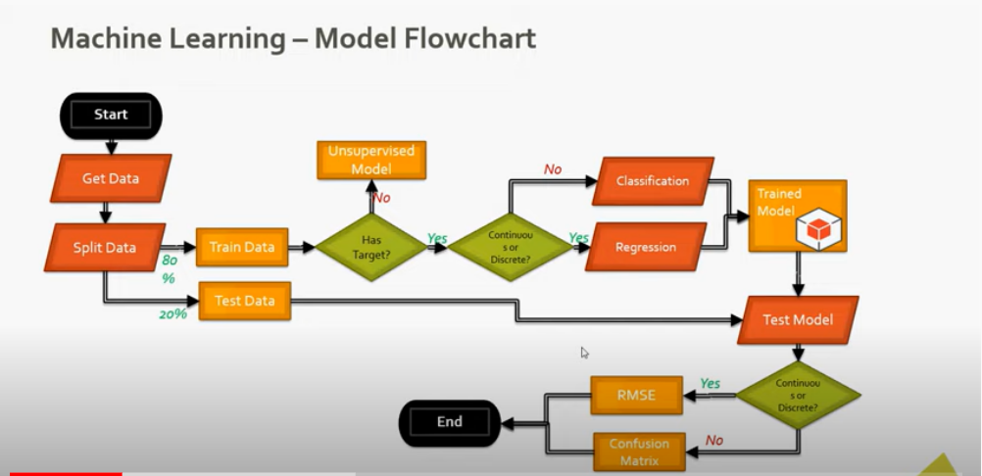
Multiple Choice Questions

Slide 11
Multiple Choice Questions
A linear regression model assumes “a linear relationship between the input variables and the single output variable.” What’s the meaning of this assumption?
The output variable can’t be calculated from a linear combination of the input variables.
The output variable can be calculated from a linear combination of the input variables
Input variables can be calculated from a linear combination of the output variables
Output variable = sum of the input variables
When there are more than one independent variables in the model, then the linear model is termed as
Unimodal
Multiple model
Multiple Linear model
Multiple Logistic model

Slide 12
Multiple Choice Questions
3. The parameter β0 is termed as intercept term and the parameter β1 is termed as slope parameter. These parameters are usually called as _________
Regressionists
Coefficients
Regressive
Regression Coefficients
4. What are the steps for using a gradient descent algorithm?
Calculate error between the actual value and the predicted value
Reiterate until you find the best weights of network
Pass an input through the network and get values from output layer
Initialize random weight and bias
Go to each neurons which contributes to the error and change its respective values to reduce the error
1,2,3,4,5
5,4,3,2,1
3,2,1,4,5
4,3,1,5,2

Slide 13
References
Mitchell T.M., Machine Learning, McGraw Hill (1997).
Chris Albon - Machine Learning with Python Cookbook_ Practical Solutions from Preprocessing to Deep Learning (2018, O’Reilly Media)
Sebastian Raschka, Vahid Mirjalili - Python Machine Learning_ Machine Learning and Deep Learning with Python, scikit-learn, and TensorFlow 2 (2019, Packt Publishing - ebooks Account)

